Slide 1
Flexible Research Platform #1 Measurement Overview Rough Draft V2
David Fugate
November 6, 2014

Slide 2
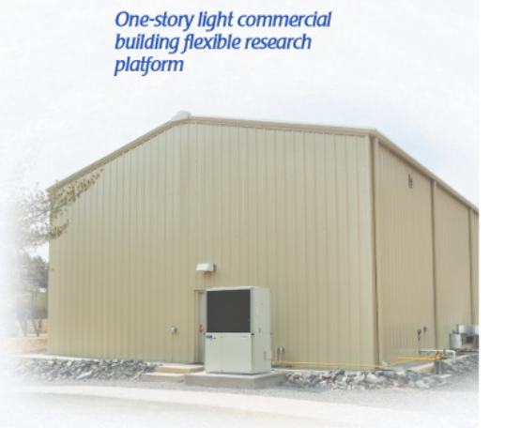
Flexible Research Platform #1 Measurement Overview
FRP 1 Building Equipment Summary
The 1-story FRP is 2,400 ft2 and is currently targeted at the energy efficiency of metal buildings.
It has two HVAC systems to facilitate operation of either a conventional gas-pack (air-conditioner with natural gas heat) or a gas-engine–driven heat pump.

Slide 3
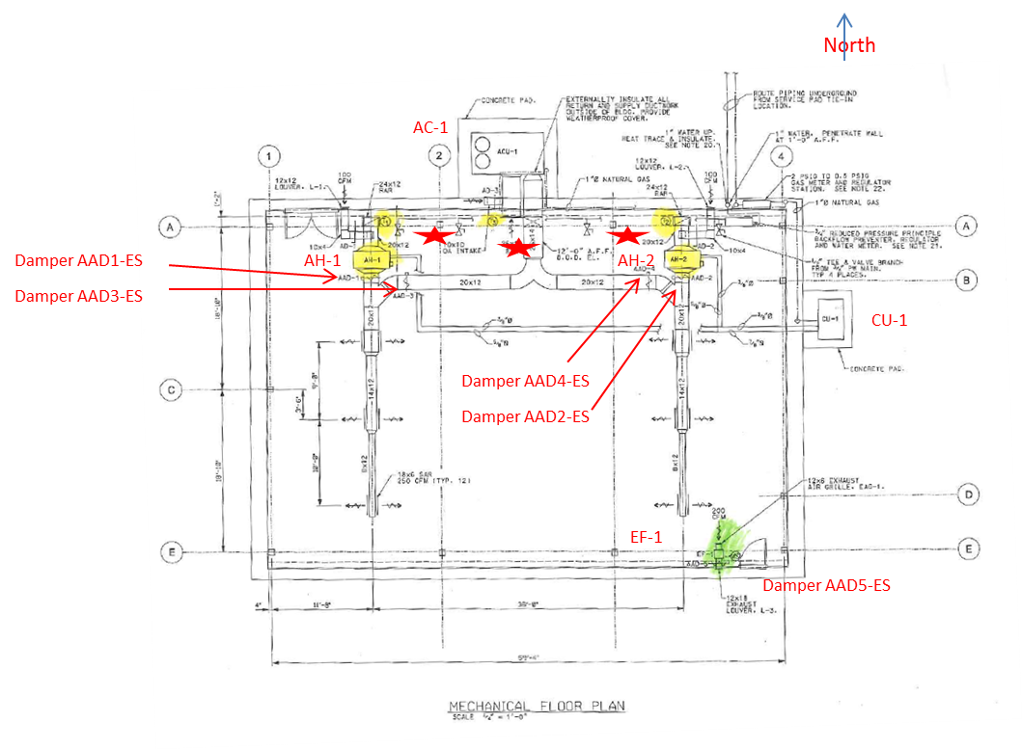
Flexible Research Platform #1 Measurement Overview
FRP 1 Building Equipment Summary
AC-1 Single Package Gas/Electric Air Conditioning Unit (Johnson Controls System)
CU-1 Split System Multi-Zone Natural Gas Driven Heat Pump (not on Johnson Controls System)
AH-1 Air Handler West
AH-2 Air Handler East
EF-1 Exhaust Fan
After some internal discussions, the ORLN team is proposing that the instrumentation and experiments focus on AC-1, AH-1, and AH-2 and will not include CU-1.
CU-1 is not typical to standard buildings today.

Slide 4
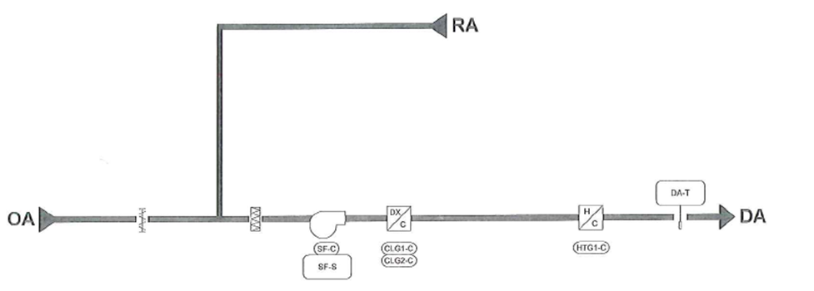
Flexible Research Platform #1 Measurement Overview
FRP 1 Building Equipment Summary
AC-1 Single Package Gas/Electric Air Conditioning Unit (Johnson Controls System)
Nordyne Mammoth R6GP Series Model RGP-090D-200Ca (SN R6F120900062), Nominal 7 ½ Ton, and 460/3/60Hz Power.
Loads
Two Outdoor Condenser Fan
Two Compressor
Blower
Controls
Device | Quantity | Voltage | Current
Blower Drive | 1 | 480vac/3ph | 2.9A
Compressor | 2 | 480vac/3ph | 6.1A
Condensor Fan | 2 | 480vac/3ph | 1.2A
Return Air
Discharge Air
1st Stage Cooling
2nd Stage Cooling
Outside Air
Stage Heating

Slide 5
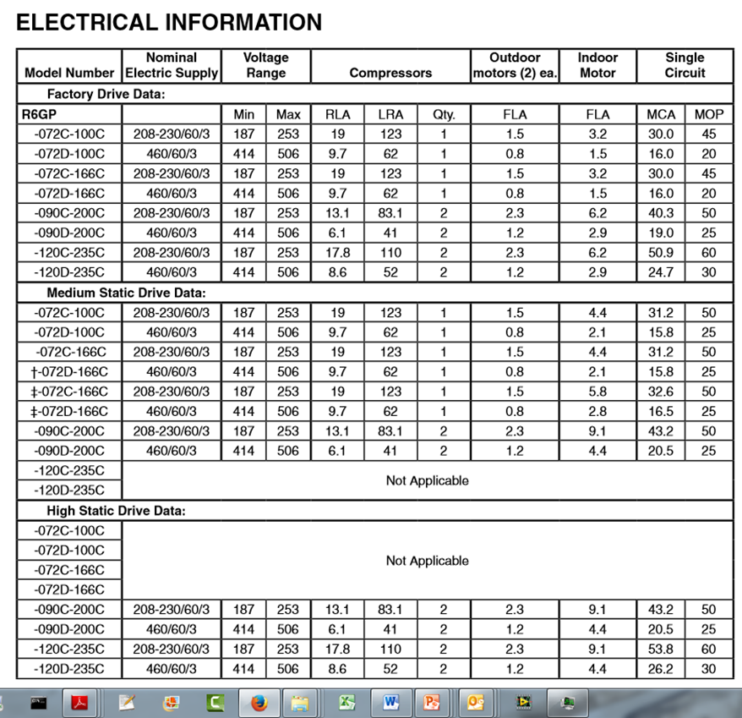
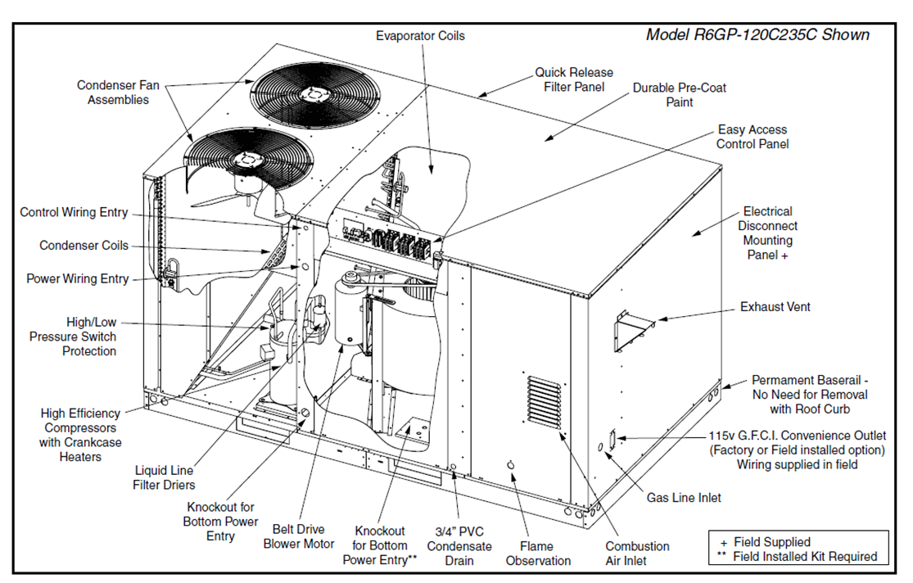
Flexible Research Platform #1 Measurement Overview
FRP 1 Building Equipment Summary
AC-1 Single Package Gas/Electric Air Conditioning Unit (Johnson Controls System)
Nordyne Mammoth R6GP Series Model RGP-090D-200Ca (SN R6F120900062), Nominal 7 ½ Ton, and 460/3/60Hz Power.
Loads
Two Outdoor Condenser Fan
Two Compressor
Blower
Controls

Slide 6
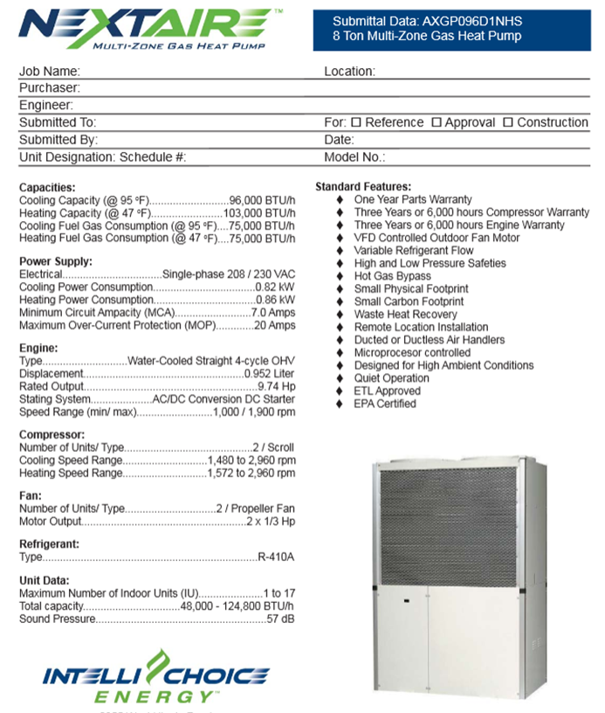
Flexible Research Platform #1 Measurement Overview
FRP 1 Building Equipment Summary
CU-1 Split System Multi-Zone Natural Gas Driven Heat Pump (not on Johnson Controls System)

Slide 7
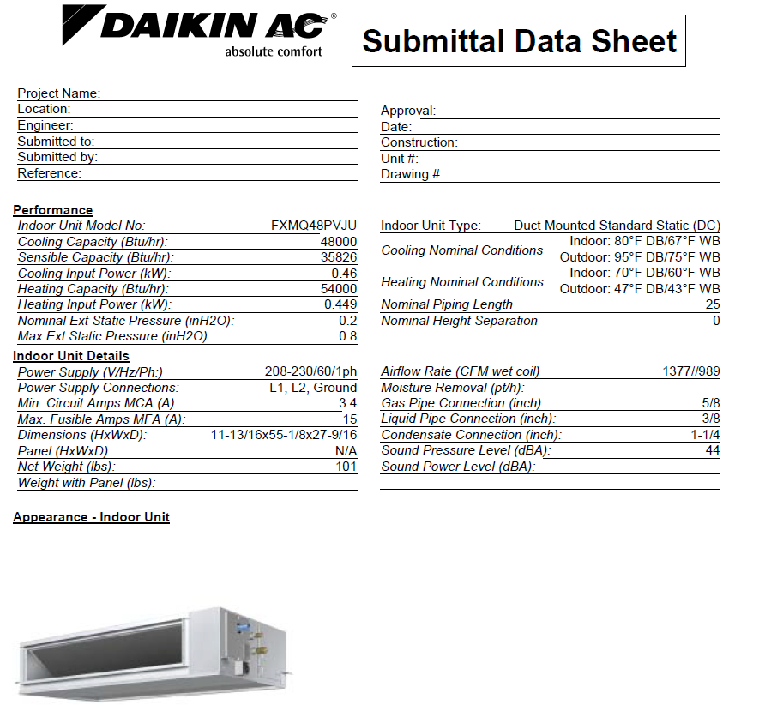
Flexible Research Platform #1 Measurement Overview
FRP 1 Building Equipment Summary
A & B AC-1 AH-1 Air Handler West & AH-2 Air Handler East
Daikin FXMQ48PVJU equal nominal 4 ton 208/1/60Hz power.

Slide 8
Flexible Research Platform #1 Measurement Overview
FRP 1 Electrical 1-Line Diagram (1/2)
Outside FRP1
Current Measurement Location
C1
Incoming Power Feed
480vac/3ph/60Hz
PGPH1 Breaker Panel
V1
Voltage Measurement Location
100 A Bkr
V1
C1
Main Feed Location
Transformer T1
ACU-1
30 A Bkrs 38/40/42
30 A Bkrs 2/4/6
C2
T1
480 to 120Y/208 Transformer
ACU-1

Slide 9
Flexible Research Platform #1 Measurement Overview
FRP 1 Electrical 1-Line Diagram (2/2)
T1
480 to 120Y/208 Transformer
120Y/208vac/60Hz
PGPL1 Breaker Panel
125 A Bkr
V2
C3
AHU-1
AHU-2
CU-1
30 A Bkrs 10/12
208vac/1ph
30 A Bkrs 16/18
208vac/1ph
30 A Bkrs 2/x/6
208vac/1ph
C6
C5
C4
AHU-1
AHU-2
CU-1

Slide 10
Flexible Research Platform #1 Measurement Overview
FRP 1 Building Summary
Current Measurements
Total of 8 CT’s.
Measurement Location | Description | Voltage | Current | Quantity of CT’s
C1 | FRP Incoming Power Feed | 480vac/3ph | 100A | 3
C2 | ACU-1 Power Feed | 480vac/3ph | 30A | 3
C3 | T1 Power Feed | 120Y208/3ph | 125A | 3
C4 | CU-1 | 208vac/1ph | 15A | 1
C5 | AHU-1 | 208vac/1ph | 15A | 1
C6 | AHU-2 | 208vac/1ph | 15A | 1

Slide 11
Flexible Research Platform #1 Measurement Overview
FRP 1 Building Summary
Voltage Measurements
Total of 6 VT measurements.
2 – 3 phase VT’s.
Measurement Location | Description | Voltage | Current | Quantity of VT’s | Notes
V1 | FRP Incoming Power Feed | 480vac/3ph | 100A | 3 | Use extra/unused 3-phase circuit breaker
V2 | T1 Power Feed | 120Y208/3ph | 125A | 3 | Use extra/unused 3-phase circuit breaker

Slide 12
Flexible Research Platform #1 Measurement Overview
ORNL Requirements for Richman Surrey Equipment
UL listed components and enclosure.
Minimum rating of Nema 1 for enclosure.

